Slide 1
PL/SQL – stored Procedures, functions,packages, cursor, trigger and exception handling
how to create and execute the named blocks (procedures and functions).

Slide 2
A subprogram is a program unit/module that performs a particular task.
These subprograms are combined to form larger programs.
This is basically called the 'Modular design'.
A subprogram can be invoked by another subprogram or program which is called the calling program.
Stored procedures:
PLSQL components: procedures, functions and packages collectively called as SPs.
Program units that can be created with PL/SQL and store in the db are standalone procedures and functions and packages.
Once stored it will be called as stored procedures.

Slide 3
Procedures and Functions are the subprograms which can be created and saved in the database as database objects.
They can be called or referred inside the other blocks also.
A subprogram can be created −
At the schema level (standalone)
Inside a package (packaged)
Inside a PL/SQL block (local)
Other types:
Private, public, one time only

Slide 4
Procedures and functions that are created outside of a package are called stored or standalone subprograms.
Procedures and functions defined within a package are known as packaged subprograms.
Procedures and functions nested inside other subprograms or within a PL/SQL block are known as local subprograms, which cannot be referenced by other applications and exist only inside of the enclosing block.

Slide 5
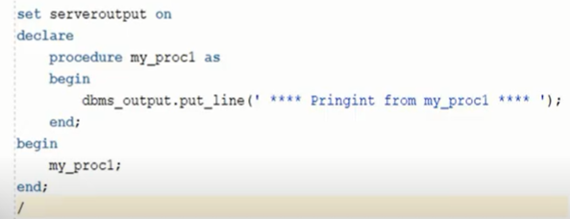
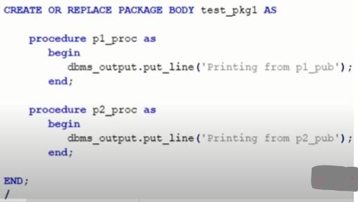
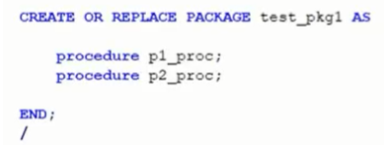
Local procedure: scope will be from begin to end of pl/sql component
Packaged procedure:

Slide 6
PL/SQL subprograms are named PL/SQL blocks that can be invoked with a set of parameters.
PL/SQL provides two kinds of subprograms −
Functions − These subprograms return a single value; mainly used to compute and return a value.
Procedures − These subprograms do not return a value directly; mainly used to perform an action.

Slide 7
Terminologies in PL/SQL Subprograms
Parameter:
The parameter is variable or placeholder of any valid PL/SQL datatype through which the PL/SQL subprogram exchange the values with the main code. This parameter allows to give input to the subprograms and to extract from these subprograms.
These parameters are included in the calling statement of these subprograms to interact the values with the subprograms.
The datatype of the parameter in the subprogram and the calling statement should be same.
The size of the datatype should not mention at the time of parameter declaration, as the size is dynamic for this type.
IN Parameter
OUT Parameter
IN OUT Parameter

Slide 8
IN Parameter:
This parameter is used for giving input to the subprograms.
It is a read-only variable inside the subprograms. Their values cannot be changed inside the subprogram.
In the calling statement, these parameters can be a variable or a literal value or an expression, for example, it could be the arithmetic expression like ‘5*8’ or ‘a/b’ where ‘a’ and ‘b’ are variables.
By default, the parameters are of IN type.
OUT Parameter:
This parameter is used for getting output from the subprograms.
It is a read-write variable inside the subprograms. Their values can be changed inside the subprograms.
IN OUT Parameter:
This parameter is used for both giving input and for getting output from the subprograms.
It is a read-write variable inside the subprograms. Their values can be changed inside the subprograms.

Slide 9
RETURN
RETURN is the keyword that instructs the compiler to switch the control from the subprogram to the calling statement.
In subprogram RETURN simply means that the control needs to exit from the subprogram.
Normally, parent or main block will call the subprograms, and then the control will shift from those parent block to the called subprograms.
RETURN in the subprogram will return the control back to their parent block.
In the case of functions RETURN statement also returns the value.
The datatype of this value is always mentioned at the time of function declaration. The datatype can be of any valid PL/SQL data type.

Slide 10
What is Procedure in PL/SQL?
A Procedure in PL/SQL is a subprogram unit that consists of a group of PL/SQL statements that can be called by name.
Each procedure in PL/SQL has its own unique name by which it can be referred to and called.
This subprogram unit in the Oracle database is stored as a database object.
Note: Subprogram is nothing but a procedure, and it needs to be created manually as per the requirement. Once created they will be stored as database objects.

Slide 11
Below are the characteristics of Procedure subprogram unit in PL/SQL:
Procedures are standalone blocks of a program that can be stored in the database
Call to these PLSQL procedures can be made by referring to their name, to execute the PL/SQL statements.
It is mainly used to execute a process in PL/SQL.
It can have nested blocks, or it can be defined and nested inside the other blocks or packages.
It contains declaration part (optional), execution part, exception handling part (optional).
The values can be passed into Oracle procedure or fetched from the procedure through parameters .
These parameters should be included in the calling statement.
A Procedure in SQL can have a RETURN statement to return the control to the calling block, but it cannot return any values through the RETURN statement.
Procedures cannot be called directly from SELECT statements. They can be called from another block or through EXEC keyword.

Slide 12
Parts of a PL/SQL Subprogram
Each PL/SQL subprogram has a name, and may also have a parameter list.
Declarative Part
It is an optional part. However, the declarative part for a subprogram does not start with the DECLARE keyword.
It contains declarations of types, cursors, constants, variables, exceptions, and nested subprograms.
These items are local to the subprogram and cease to exist when the subprogram completes execution.
Executable Part
This is a mandatory part and contains statements that perform the designated action.
Exception-handling
This is again an optional part. It contains the code that handles run-time errors.

Slide 13
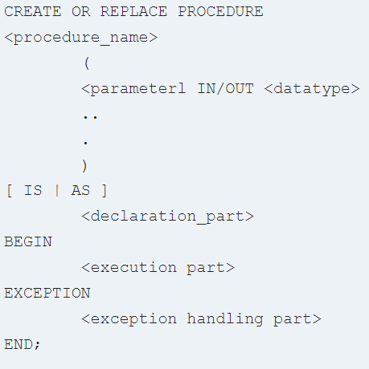
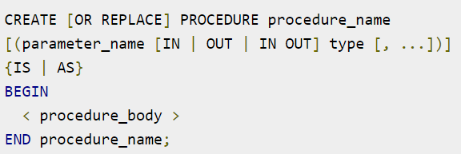
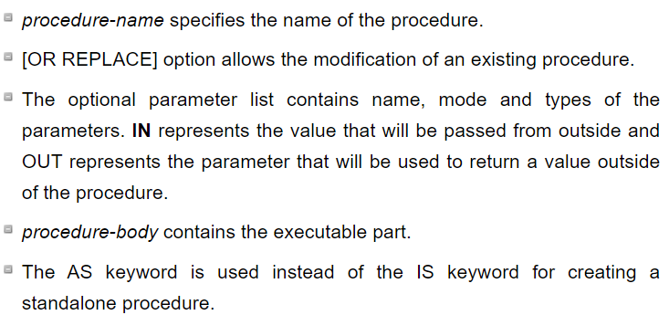
Creating a Procedure
A procedure is created with the CREATE OR REPLACE PROCEDURE statement. The simplified syntax for the CREATE OR REPLACE PROCEDURE statement is as follows −
Keyword ‘IS’ will be used, when the stored procedure in Oracle is nested into some other blocks.
If the procedure is standalone then ‘AS’ will be used.

Slide 14
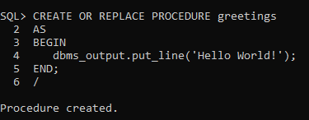
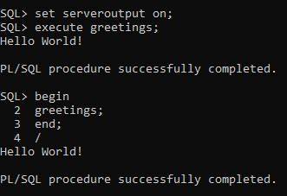

Standalone Procedure:
Executing a Standalone Procedure:
can be called in two ways −
Using the EXECUTE keyword.
Calling the name of the procedure from a PL/SQL block

Slide 15
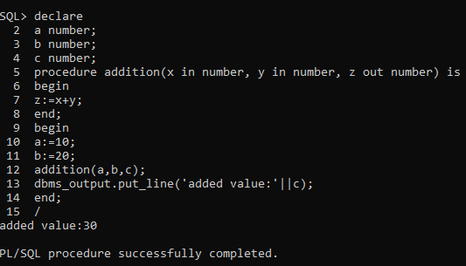
LOCAL PROCEDURE with IN, OUT parameters
SQL> declare
2 a number;
3 b number;
4 c number;
5 procedure addition(x in number, y in number, z out number) is
6 begin
7 z:=x+y;
8 end;
9 begin
10 a:=10;
11 b:=20;
12 addition(a,b,c);
13 dbms_output.put_line('added value:'||c);
14 end;
15 /
added value:30
PL/SQL procedure successfully completed.

Slide 16
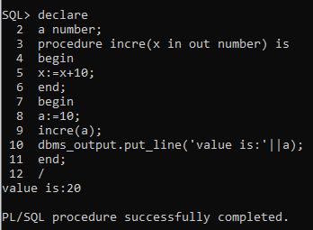
IN OUT parameter:
SQL> declare
2 a number;
3 procedure incre(x in out number) is
4 begin
5 x:=x+10;
6 end;
7 begin
8 a:=10;
9 incre(a);
10 dbms_output.put_line('value is:'||a);
11 end;
12 /
value is:20
PL/SQL procedure successfully completed.

Slide 17
Methods for Passing Parameters
Actual parameters can be passed in three ways −
Positional notation
Named notation
Mixed notation

Slide 18
Positional Notation
In positional notation, you can call the procedure as −
findMin(a, b, c, d);
In positional notation, the first actual parameter is substituted for the first formal parameter; the second actual parameter is substituted for the second formal parameter, and so on. So, a is substituted for x, b is substituted for y, c is substituted for z and d is substituted for m.
Named Notation
In named notation, the actual parameter is associated with the formal parameter using the arrow symbol ( => ). The procedure call will be like the following −
findMin(x => a, y => b, z => c, m => d);
Mixed Notation
In mixed notation, you can mix both notations in procedure call; however, the positional notation should precede the named notation.
The following call is legal −
findMin(a, b, c, m => d);
However, this is not legal:
findMin(x => a, b, c, d);

Slide 19
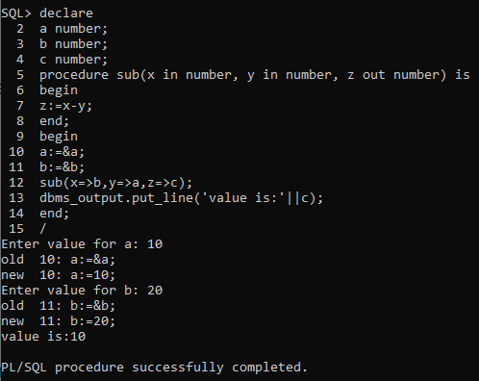
SQL> declare
2 a number;
3 b number;
4 c number;
5 procedure sub(x in number, y in number, z out number) is
6 begin
7 z:=x-y;
8 end;
9 begin
10 a:=&a;
11 b:=&b;
12 sub(x=>b,y=>a,z=>c);
13 dbms_output.put_line('value is:'||c);
14 end;
15 /
Enter value for a: 10
old 10: a:=&a;
new 10: a:=10;
Enter value for b: 20
old 11: b:=&b;
new 11: b:=20;
value is:10
PL/SQL procedure successfully completed.

Slide 20
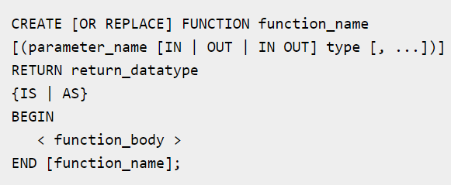
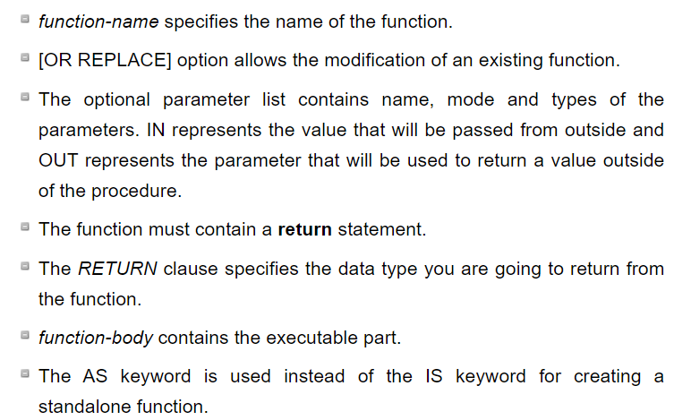
Functions
A function is same as a procedure except that it returns a value.

Slide 21
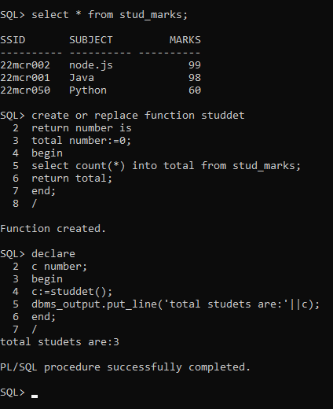
SQL> select * from stud_marks;
SSID SUBJECT MARKS
---------- ---------- ----------
22mcr002 node.js 99
22mcr001 Java 98
22mcr050 Python 60
SQL> create or replace function studdet
2 return number is
3 total number:=0;
4 begin
5 select count(*) into total from stud_marks;
6 return total;
7 end;
8 /
Function created.
SQL> declare
2 c number;
3 begin
4 c:=studdet();
5 dbms_output.put_line('total studets are:'||c);
6 end;
7 /
total studets are:3
PL/SQL procedure successfully completed.

Slide 22
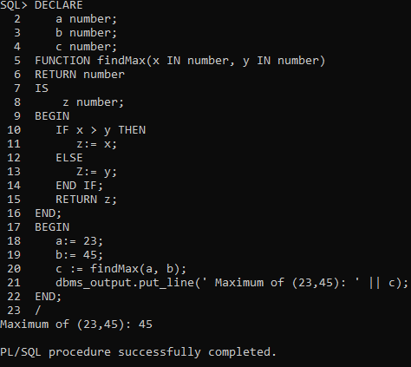
SQL> DECLARE
2 a number;
3 b number;
4 c number;
5 FUNCTION findMax(x IN number, y IN number)
6 RETURN number
7 IS
8 z number;
9 BEGIN
10 IF x > y THEN
11 z:= x;
12 ELSE
13 Z:= y;
14 END IF;
15 RETURN z;
16 END;
17 BEGIN
18 a:= 23;
19 b:= 45;
20 c := findMax(a, b);
21 dbms_output.put_line(' Maximum of (23,45): ' || c);
22 END;
23 /
Maximum of (23,45): 45
PL/SQL procedure successfully completed.

Slide 23
PACKAGES

Slide 24
PACKAGES
A package is a way of logically storing the subprograms like procedures, functions, exception or cursor into a single common unit.
A package can be defined as an oracle object that is compiled and stored in the database,where many applications can share its contents.
Components of Package
Package has two basic components:
Specification: It is the declaration section of a Package
Body: It is the definition section of a Package.

Slide 25
Package specification:
The package specification is the package interface which declares the types, variables, constants, exceptions, cursors and subprograms that can be referenced from outside the package. Note: All objects in the package specification are known as public objects.

Slide 26
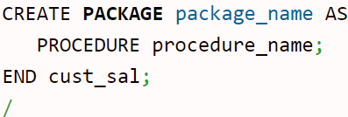
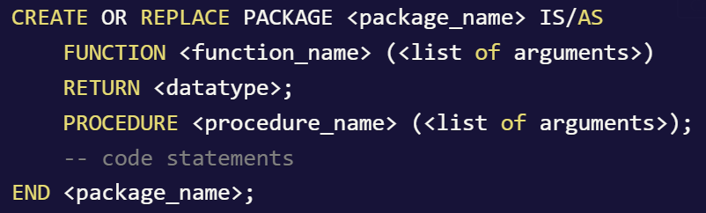
Syntax of package specification/declaration:
Example:
CREATE PACKAGE cust_sal AS
PROCEDURE find_sal(c_id customers.id%type);
END cust_sal; //

Slide 27
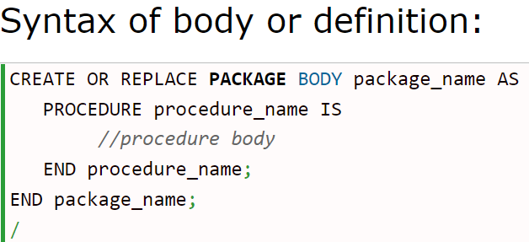
Package body or definition:
The package body or definition defines the queries for the cursors and the code for the subprograms. Note: All objects in the package body or definition are known as private objects.
Example:
CREATE OR REPLACE PACKAGE BODY cust_sal AS
PROCEDURE find_sal(c_id customers.id%TYPE) IS
c_sal customers.salary%TYPE;
BEGIN
SELECT salary INTO c_sal
FROM customers
WHERE id = c_id;
dbms_output.put_line('Salary: '|| c_sal);
END find_sal;
END cust_sal;
/ =>Package body created.

Slide 28
Using the Package Elements
The package elements (variables, procedures or functions) are accessed with the following syntax −
package_name.element_name;
Example:
DECLARE
code customers.id%type := &cc_id;
BEGIN
cust_sal.find_sal(code);
END;
/
Enter value for cc_id: 1
Salary: 3000
PL/SQL procedure successfully completed.

Slide 29
SQL> create or replace package samp_pack as
2 procedure add(n1 IN number, n2 IN number,r OUT number);
3 end samp_pack;
4 /
Package created.
SQL> create or replace package body samp_pack as
2 procedure add(n1 IN number, n2 IN number, r OUT number) as
3 begin
4 r:=n1+n2;
5 end add;
6 end samp_pack;
7 /
Package body created.
SQL> declare
2 x number:=&x;
3 y number:=&y;
4 z number;
5 begin
6 samp_pack.add(x,y,z);
7 end;
8 /
Enter value for x: 10
old 2: x number:=&x;
new 2: x number:=10;
Enter value for y: 20
old 3: y number:=&y;
new 3: y number:=20;
PL/SQL procedure successfully completed.

Slide 30
Example for procedure overloading with package
SQL> CREATE PACKAGE overloadingprocedure AS
2 Procedure overl_method (p varchar2);
3 Procedure overl_method (numbr number);
4 END overloadingprocedure;
5 /
Package created.
SQL> CREATE OR REPLACE PACKAGE BODY overloadingprocedure AS
2 --procedure implemented
3 Procedure overl_method (p varchar2) AS
4 BEGIN
5 DBMS_OUTPUT.PUT_LINE ('First Procedure: ' || p);
6 END;
7 --procedure implemented
8 Procedure overl_method (numbr number) AS
9 BEGIN
10 DBMS_OUTPUT.PUT_LINE ('Second Procedure: ' || numbr);
11 END;
12 END;
13 /
Package body created.
SQL> BEGIN
2 overloadingprocedure.overl_method ('Software Testing Help');
3 overloadingprocedure.overl_method (1);
4 END;
5 /
First Procedure: Software Testing Help
Second Procedure: 1
PL/SQL procedure successfully completed.

Slide 31
SQL> select * from user_procedures;
PLSQL Package Dependency
The package dependencies in PL/SQL are listed below:
A package specification is an independent identity.
Package body is dependent on the package specification.
A package body can only be compiled separately.
However, if a package specification is compiled then the body needs to be compiled again.

Slide 32
Cursor CURrent Set Of Records

Slide 33
Cursor in SQL
To execute SQL statements, a work/context area (predefined area in the main memory Set) is used by the Oracle engine for its internal processing and storing the information.
Simply saying, Oracle uses temporary work area cursor for storing output of an SQL statement.
This work area is private to SQL’s operations.
The ‘Cursor’ is the PL/SQL construct that allows the user to name the work area and access the stored information in it.
A Cursor is a pointer to this context area.
PL/SQL allows the programmer to control the context area through the cursor.
A cursor holds the rows returned by the SQL statement.
The set of rows the cursor holds is referred as active set.
These cursors can also be named so that they can be referred from another place of the code.
The cursor is defined and used within the block of stored procedure which means it can be only used with PL/SQL.

Slide 34
A view is a virtual table that gives logical view of data from base table.
A CURSOR (CURrent Set of Records) is a temporary workstation created in the database server when the SQL statement is executed.

Slide 35
Types of cursors
The cursor is of two types.
Implicit Cursor
Explicit Cursor
Implicit Cursor
Whenever any DML operations occur in the database, an implicit cursor is automatically created that holds the rows affected, in that particular operation.
These cursors cannot be named and, hence they cannot be controlled or referred from another place of the code. We can refer only to the most recent cursor through the cursor attributes.
Explicit Cursor
Programmers are allowed to create named context area to execute their DML operations to get more control over it. The explicit cursor should be defined in the declaration section of the PL/SQL block, and it is created for the ‘SELECT’ statement that needs to be used in the code.

Slide 36
Cursor Actions
Declaring the cursor: Declaring the cursor simply means to create one named context area for the ‘SELECT’ statement that is defined in the declaration part. The name of this context area is same as the cursor name.
Opening Cursor : Opening the cursor will instruct the PL/SQL to allocate the memory for this cursor. It will make the cursor ready to fetch the records.
Fetching Data from the Cursor: In this process, the ‘SELECT’ statement is executed and the rows fetched is stored in the allocated memory. These are now called as active sets. Fetching data from the cursor is a record-level activity that means we can access the data in a record-by-record way. Each fetch statement will fetch one active set and holds the information of that particular record. This statement is same as ‘SELECT’ statement that fetches the record and assigns to the variable in the ‘INTO’ clause, but it will not throw any exceptions.
Closing the Cursor: Once all the record is fetched now, we need to close the cursor so that the memory allocated to this context area will be released.
Deallocate: Finally, delete the cursor definition and release all the system resources associated with the cursor.

Slide 37
How to use Explicit Cursor?
There are four steps in using an Explicit Cursor.
DECLARE the cursor in the Declaration section.
OPEN the cursor in the Execution Section.
FETCH the data from the cursor into PL/SQL variables or records in the Execution Section.
CLOSE the cursor in the Execution Section before you end the PL/SQL Block.

Slide 38
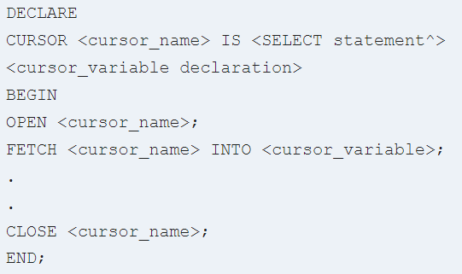
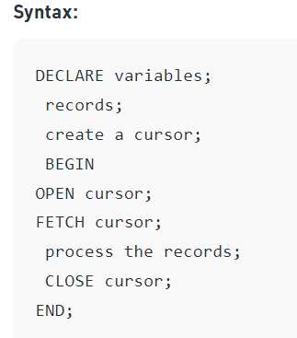
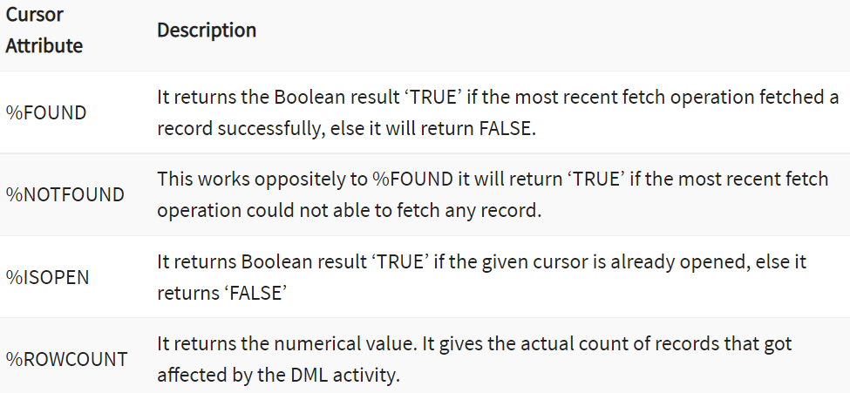

Slide 39
Example for implicit cursor with cursor attributes
SQL> set serveroutput on;
SQL> declare
2 totalcount number;
3 begin
4 update stud_marks set marks=70 where ssid='22mcr050';
5 if sql%notfound then
6 dbms_output.put_line('no marks updated');
7 elsif sql%found then
8 totalcount:=sql%rowcount;
9 dbms_output.put_line(totalcount||' affected');
10 end if;
11 end;
12 /
1 affected
PL/SQL procedure successfully completed.
SQL%FOUND, SQL%NOTFOUND, and SQL%ROWCOUNT are PL/SQL attributes that can be used to determine the effect of an SQL statement.
The SQL%FOUND attribute has a Boolean value that returns TRUE if at least one row was affected by an INSERT, UPDATE, or DELETE statement, or if a SELECT INTO statement retrieved one row.
SQL%ROWCOUNT returns the numbers of rows affected by the most recent INSERT, UPDATE, or DELETE statement executed in your session.

Slide 40
Example for Explicit cursor
SQL> declare
2 id stud_marks.ssid%type;
3 sub stud_marks.subject%type;
4 mark stud_marks.marks%type;
5 cursor stud_cur is select * from stud_marks;
6 begin
7 open stud_cur;
8 loop
9 fetch stud_cur into id,sub,mark;
10 exit when stud_cur%notfound;
11 dbms_output.put_line(id||' '||sub||' '||mark);
12 end loop;
13 close stud_cur;
14 end;
15 /
22mcr002 node.js 99
22mcr001 Java 98
22mcr050 Python 70
PL/SQL procedure successfully completed.

Slide 41
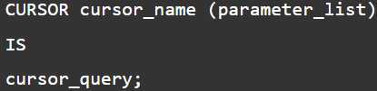

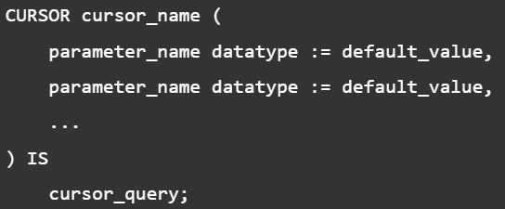
Parameterized cursors
An explicit cursor may accept a list of parameters.
Each time you open the cursor, you can pass different arguments to the cursor, which results in different result sets.
parameterized cursor with default values
A parameterized cursor can have default values for its parameters.
If you open the parameterized cursor without passing any argument, the cursor will use the default values for its parameters.

Slide 42
Example: Parameterized cursor
SQL> declare
2 myrec stud_marks%rowtype;
3 cursor c1(max_mark number) is
4 select * from stud_marks where marks<max_mark;
5 begin
6 open c1(80);
7 loop
8 fetch c1 into myrec;
9 exit when c1%notfound;
10 dbms_output.put_line(‘id='||myrec.ssid||'marks:'||myrec.marks);
11 end loop;
12 close c1;
13 end;
14 /
id=22mcr050marks:70
PL/SQL procedure successfully completed.
Note:
%RowType is used to fetch the entire rows of the table
whereas
the %Typeis used to fetch the enire columns of the table of the views or variables.

Slide 43
With default value
SQL> declare
2 myrec stud_marks%rowtype;
3 cursor c1(max_mark number :=100) is
4 select * from stud_marks where marks<max_mark;
5 begin
6 open c1;
7
8 loop
9 fetch c1 into myrec;
10 exit when c1%notfound;
11 dbms_output.put_line('is='||myrec.ssid||'marks:'||myrec.marks);
12 end loop;
13 close c1;
14 end;
15 /
is=22mcr002marks:99
is=22mcr001marks:98
is=22mcr050marks:70
PL/SQL procedure successfully completed.

Slide 44
Workout Problems
Given the table EMPLOYEE (EmpNo, Name, Salary, Designation, DeptID) write a cursor to select the five highest paid employees from the table. EMPLOYEE (EmpNo, Name, Salary, Designation, DeptID)
Write a PL/SQL block that will display the employee details along with salary using cursors.
To write a Cursor to display the list of employees who are working as a Managers or Analyst.
To write a Cursor to find employee with given designation and deptid.
Write a PL/SQL block using implicit cursor that will display message, the salaries of all the employees in the „employee‟ table are updated. If none of the employee‟s salary are updated we get a message 'None of the salaries were updated'. Else we get a message like for example, 'Salaries for 1000 employees are updated' if there are 1000 rows in „employee‟ table
To write a Cursor to display the list of employees getting>50000 salary.
Display salary of all employee in descending order using cursor?
Write a query to find the details of those employee who have same job using cursor?
Write a query to show dept where no sales representative works using cursor?
CREATE TABLE EMPLOYEE (
EMPNO INTEGER PRIMARY KEY,
NAME VARCHAR(20),
SALARY NUMBER(7,2),
DESIGNATION VARCHAR(10),
DEPTID INTEGER);

Slide 45
1 declare
2 i number:=0;
3 cursor ec is select empno, name, salary from employee order salary desc;
4 r%rowtype;
5 begin
6 open ec;
7 loop
8 exit when i=5;
9 fetch ec into r;
10 dbms_output.put_line(r.emp_no||' '||r.employee_name||' '||r.salary);
11 i:=i+1;
12 end loop;
13 close ec;
14 end;
15 /

Slide 46
DECLARE
cursor c1 is select * from emp order by sal desc;
a c1%rowtype;
begin
open c1;
loop
fetch c1 into a;
exit when c1%rowcount>6;
dbms_output.put_line(a.ename||' '||a.sal||' '||a.job||'
'||C1%ROWCOUNT);
end loop;
close c1;
end;

